Slide 1



Advanced Short Circuit Preventive Mechanism for Electric Vehicles
Submitted by
SHANJAY R K | (927621BEC195)
SIVARAMAKRISHNAN M | (927621BEC201)
SUBASH P | (927621BEC213)
YASAR S | (927621BEC245)
Guided By
Dr.K.Sheikdavood (AP/ECE)

Slide 2
Objective
Our project aims to revolutionize electrical safety in electric vehicles by developing an advanced short circuit preventive mechanism. By leveraging real-time monitoring, AI-based predictive analytics, and self-healing technology, the system enhances safety and ensures proactive risk mitigation. Focus on system reliability, energy efficiency, and scalability, this solution is designed to protect critical components, reduce downtime, and adapt seamlessly to future technological advancements, setting a new standard for sustainable and secure electric vehicle operations.

Slide 3
Literature Review Table
Author | Title | Year of published | Drawback
D. Qiao et al | "Quantitative Diagnosis of Internal Short Circuit for Lithium-Ion Batteries Using Relaxation Voltage" | 2024, IEEE Transactions on Industrial Electronics | Focuses primarily on diagnosis without providing real-time mitigation strategies for detected faults.
Z. Sun et al. | "An Online Data-Driven Fault Diagnosis and Thermal Runaway Early Warning for Electric Vehicle Batteries" | 2022, IEEE Transactions on Power Electronics | Limited to battery systems; lacks consideration of external factors like environmental conditions.
F. Kaya and O. Akar | "Short Circuit Effects on HV Feeders of Optimally Located Electric Vehicle Fast Charging Stations" | 2024, IEEE Access | Addresses stationary systems only; does not factor in dynamic or mobile EV charging scenarios.

Slide 4
Existing System
Fuse Protection
Current Limiting Device
Electronic Safety Relays
Ground Fault Detection

Slide 5
Proposed Methodology
Real-time Short Circuit Detection
Automated Circuit Isolation Mechanism
AI-Based Predictive Analytics
Thermal and Voltage Monitoring

Slide 6
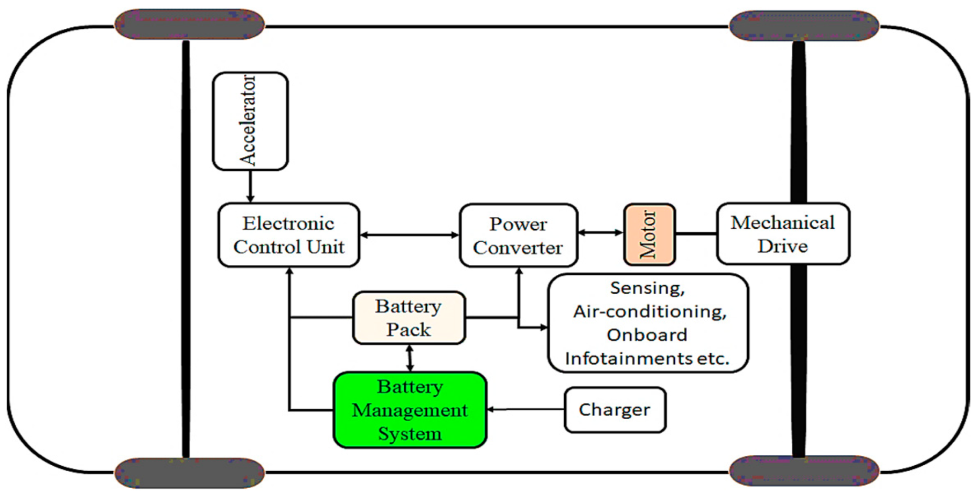
Block Diagram/Flow of Proposed Method

Slide 7
Proposed Methodology Explanation
The ASCPM can be implemented using hardware components like ESP32 for real-time monitoring, Hall effect sensors for current sensing, and thermocouples for thermal tracking. The Electronic Control Unit (ECU) processes AI-driven predictive analytics using TensorFlow Lite on an embedded system.
MOSFET-based circuit breakers enable automated isolation, while a Long Short-Term Memory (LSTM) neural network is used for predictive maintenance, analyzing historical thermal and voltage data to anticipate failures.

Slide 8
Plan for Implementation
Smart Circuit Protection System (Real-Time Monitoring)
Advanced Fault Detection Algorithms (AI-Based Prediction)
High-Speed Solid-State Circuit Breakers (SSCB)
Dynamic Load Balancing & Thermal Management

Slide 9
Expected Results
Automated Circuit Isolation
Systematic Component Disconnection
Proactive approach
Fault Prediction by continuously Monitoring the electrical Parameters

Slide 10
Project Module Completion Status
Implementation of EV Structure : 25%

Slide 11
Advantages
Real-time detection allows quicker response to short circuits, minimizing damage.
AI-based predictive analytics enhance maintenance scheduling, reducing downtime.
Automated circuit isolation ensures rapid protection
System recovery without manual intervention.

Slide 12
Applications
Electric Vehicle Safety Systems
Autonomous & Connected Vehicles
Battery Energy Storage Systems (BESS)
Smart Grids & Power Distribution

Slide 13
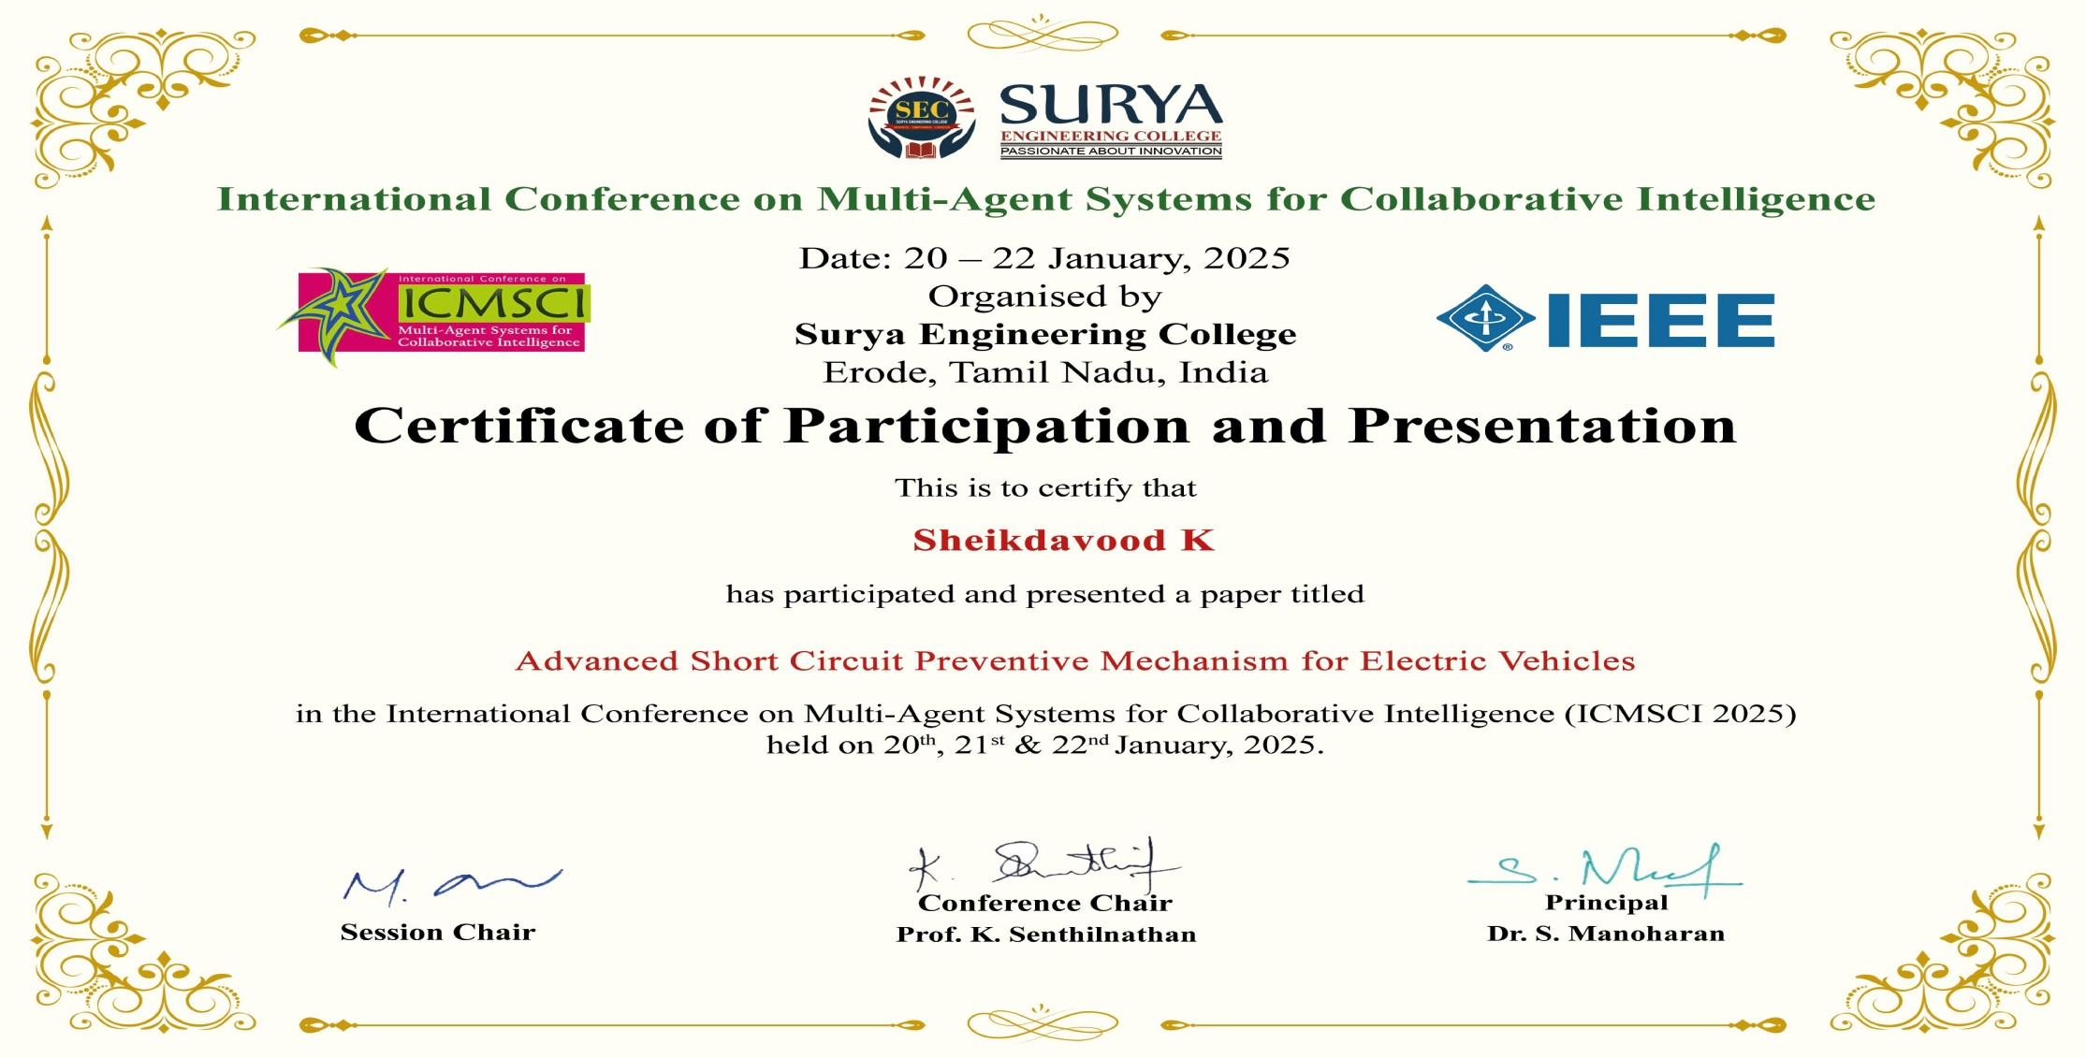
Project Outcome Status as on date Detail(Proof)
.

Slide 14

.
.

Slide 15

.
.

Slide 16

.
.

Slide 17

.
.

Slide 18
Reference
[1] D. Qiao et al., "Quantitative Diagnosis of Internal Short Circuit for Lithium-Ion Batteries Using Relaxation Voltage," in IEEE Transactions on Industrial Electronics, vol. 71, no. 10, pp. 13201-13210, Oct. 2024,doi: 10.1109/TIE.2023.3342289.
[2] D. Walch, A. Geiger and C. Sültrop, "Inter-Turn Short Circuit Faults and Mitigation Measures for Dual-Three Phase Machines," 2024 International Conference on Electrical Machines (ICEM), Torino, Italy, 2024, pp. 1-7, doi: 10.1109/ICEM60801.2024.10700240.
[3] I. Husain et al., "Electric Drive Technology Trends, Challenges, and Opportunities for Future Electric Vehicles," in Proceedings of the IEEE, vol. 109, no. 6, pp. 1039-1059, June 2021,doi: 10.1109/JPROC.2020.3046112.
[4] A. Jose, A. M. Varghese, F. E. Jenson, P. Jacob, D. M. Anumod and D. Thomas, "Solid-State Circuit Breaker based Smart Distribution Board with IoT Integration," 2020 Third International Conference on Smart Systems and Inventive Technology (ICSSIT), Tirunelveli, India, 2020, pp. 54-61, doi: 10.1109/ICSSIT48917.2020.9214172.

